Slide 1
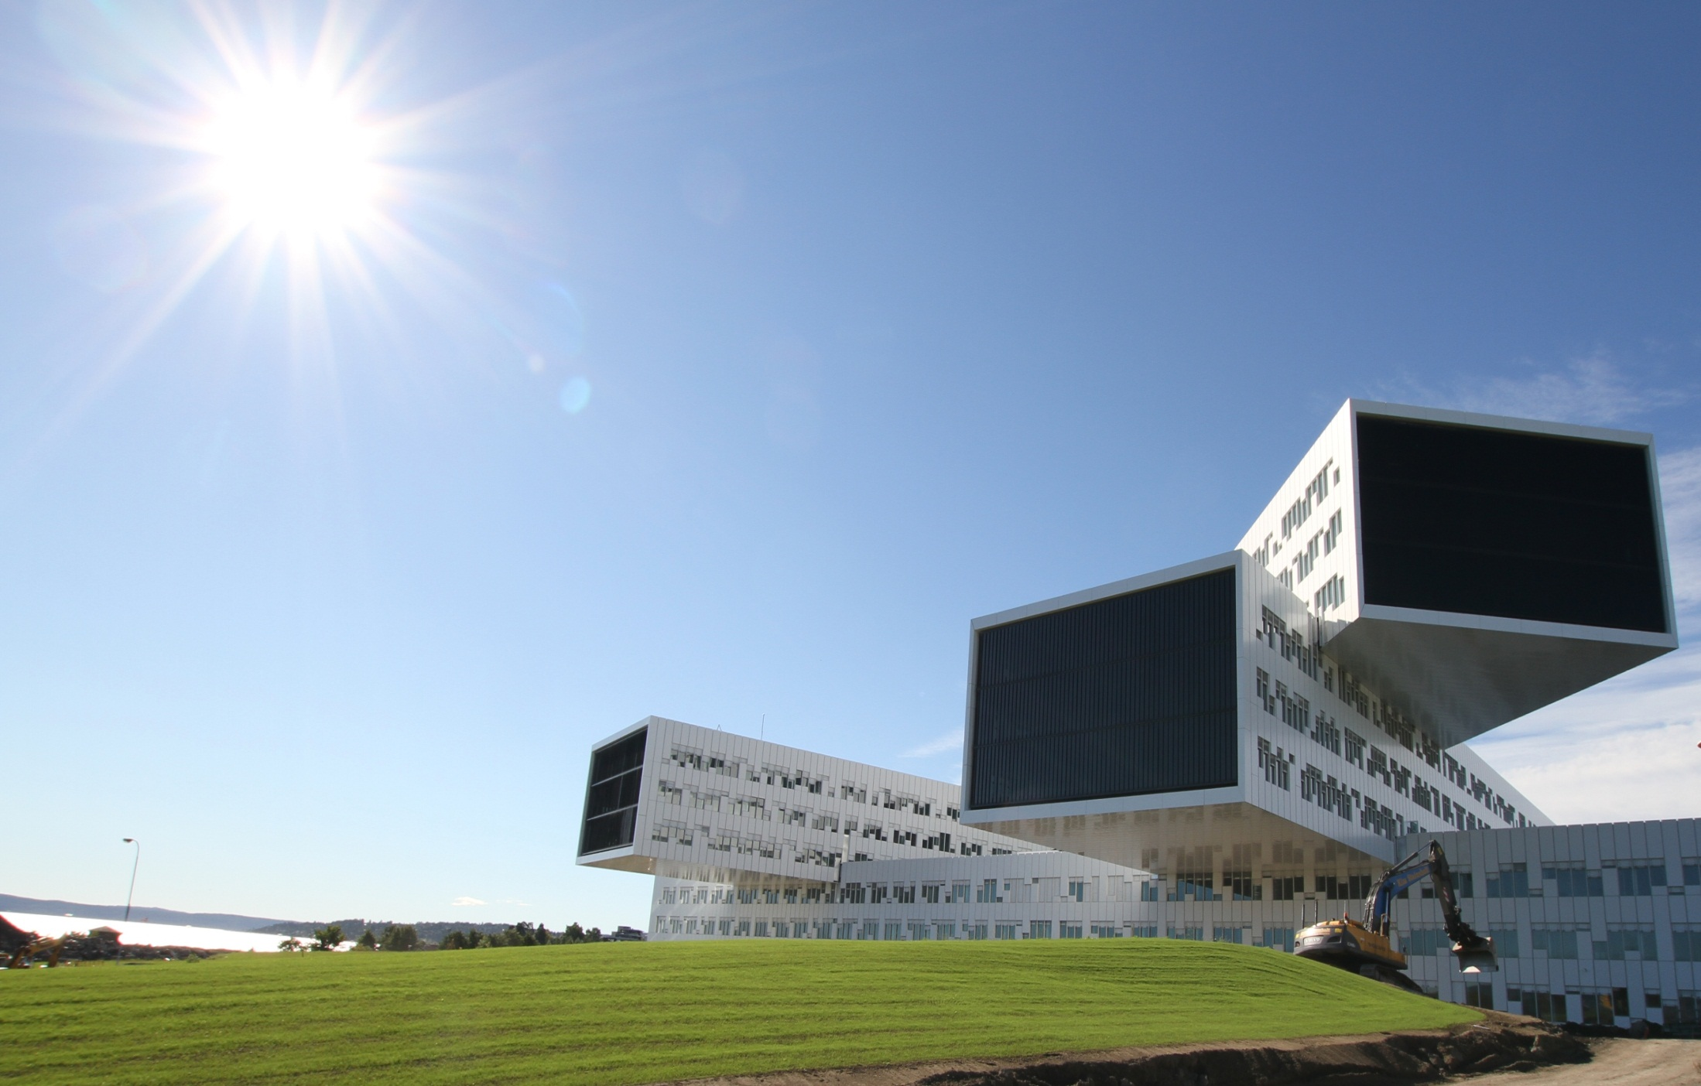
Global Expert Group webinar
Skanska Norway – Statoil Fornebu
Advanced indoor climate
Spectacular
architecture
Short construction time

Slide 2
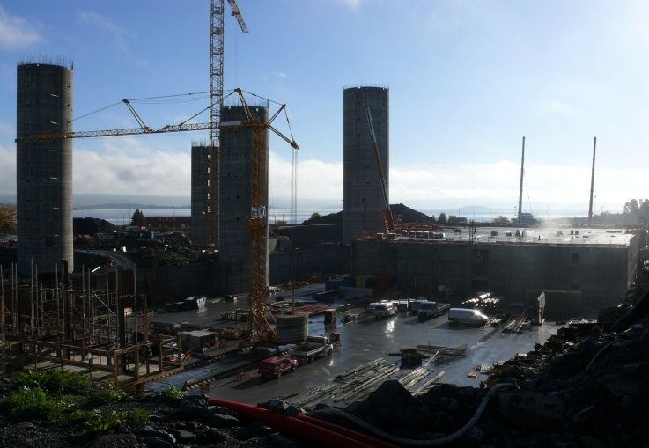
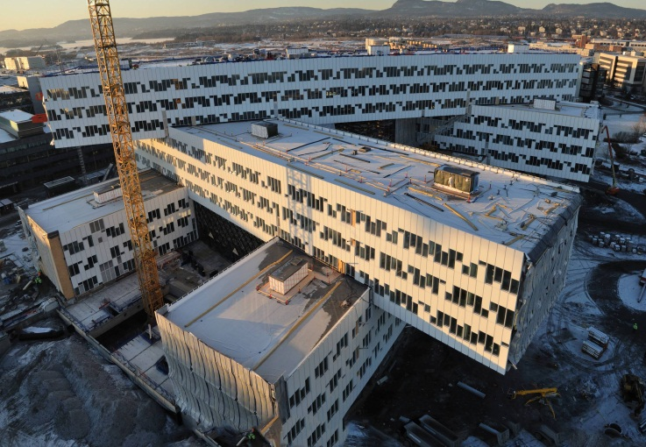
Skanska Norway - Statoil Fornebu
Facts – short construction time
67.000m2 in 20 months turnover 8 MEUR p/m.
Challenges – short construction time
Challenge due to short construction time amount of advanced technology test period should have been 3 months

Slide 3
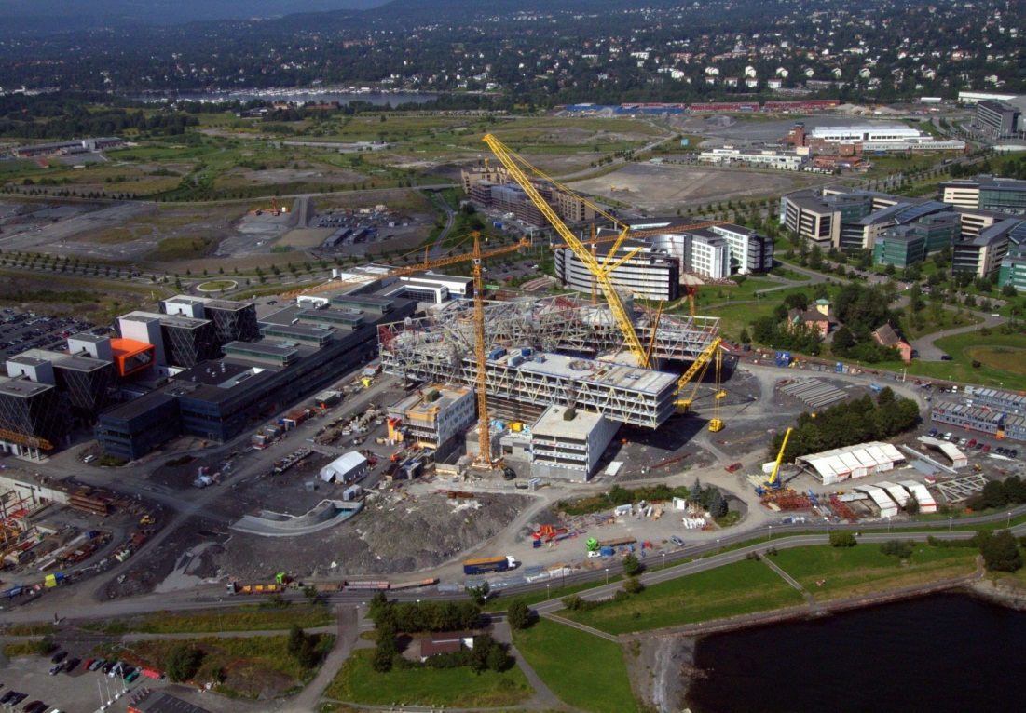
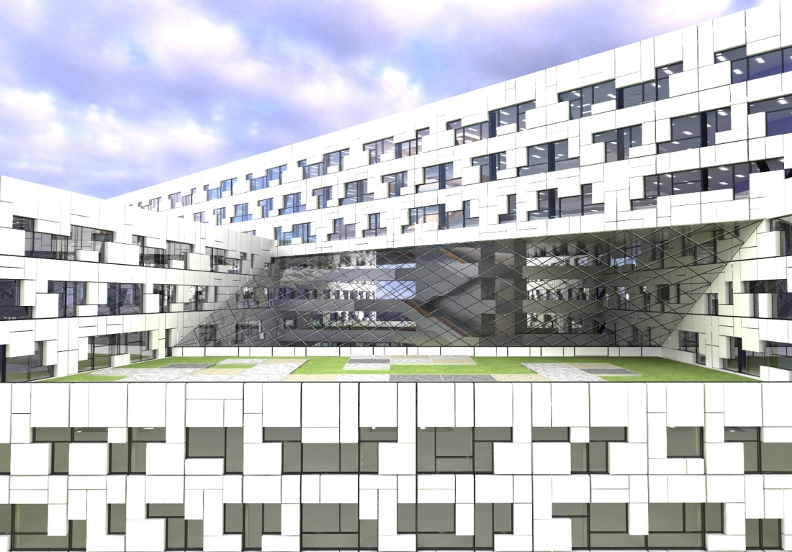
Skanska Norway - Statoil Fornebu
Learning points – short construction time
Intensive construction time scale requires good mobilization both quality and time
Important to respect testing phase building this hi-tech requires extensive testing

Slide 4
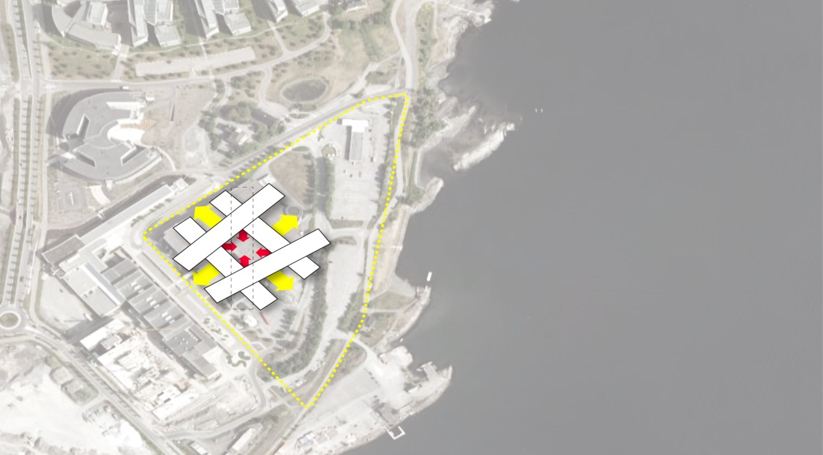
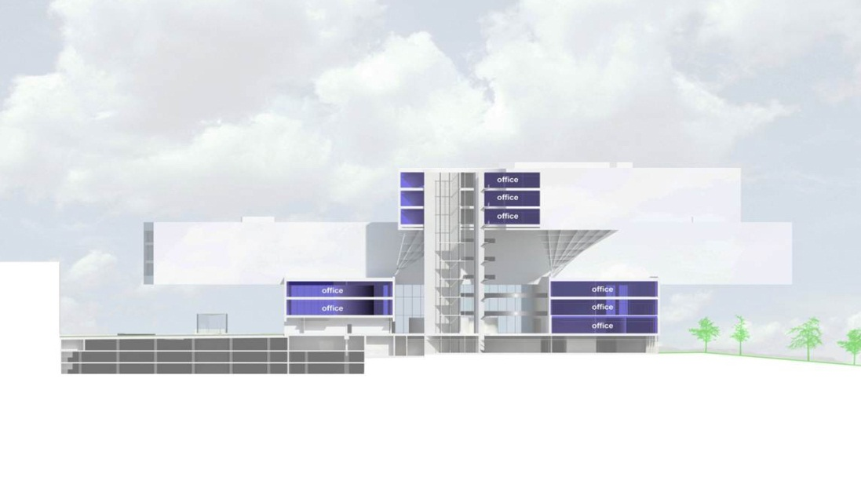
Skanska Norway - Statoil Fornebu
Facts – spectacular architecture
Large span maximum span for supporting structure is 55 meters up to 30 meter cantilever High Risk Structure Team involved
Inspired by Mikado consists of five building shells which are column-free and three floors high
Mikado

Slide 5
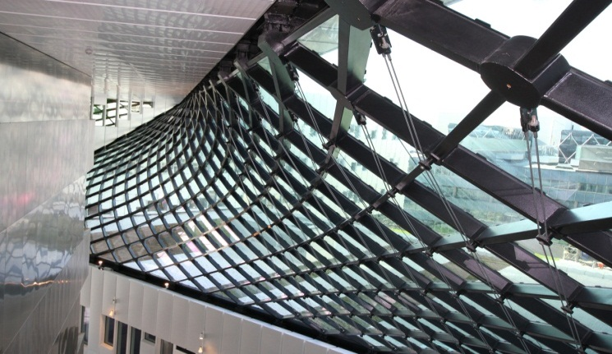
Skanska Norway - Statoil Fornebu
Challenges - spectacular architecture
Load-bearing steel beams were prefabricated with a camber of 120mm no more than 10mm camber upon completion. “Zero” deviation
Supported by 16 columns load on each column varies from 3000 to 5800 tonnes.
Construction of the glass roof in conjuction with building shells

Slide 6
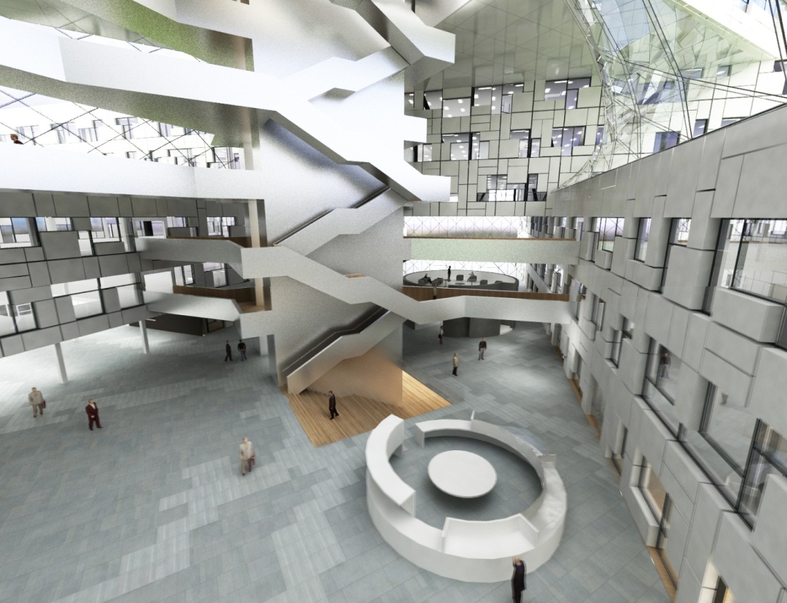
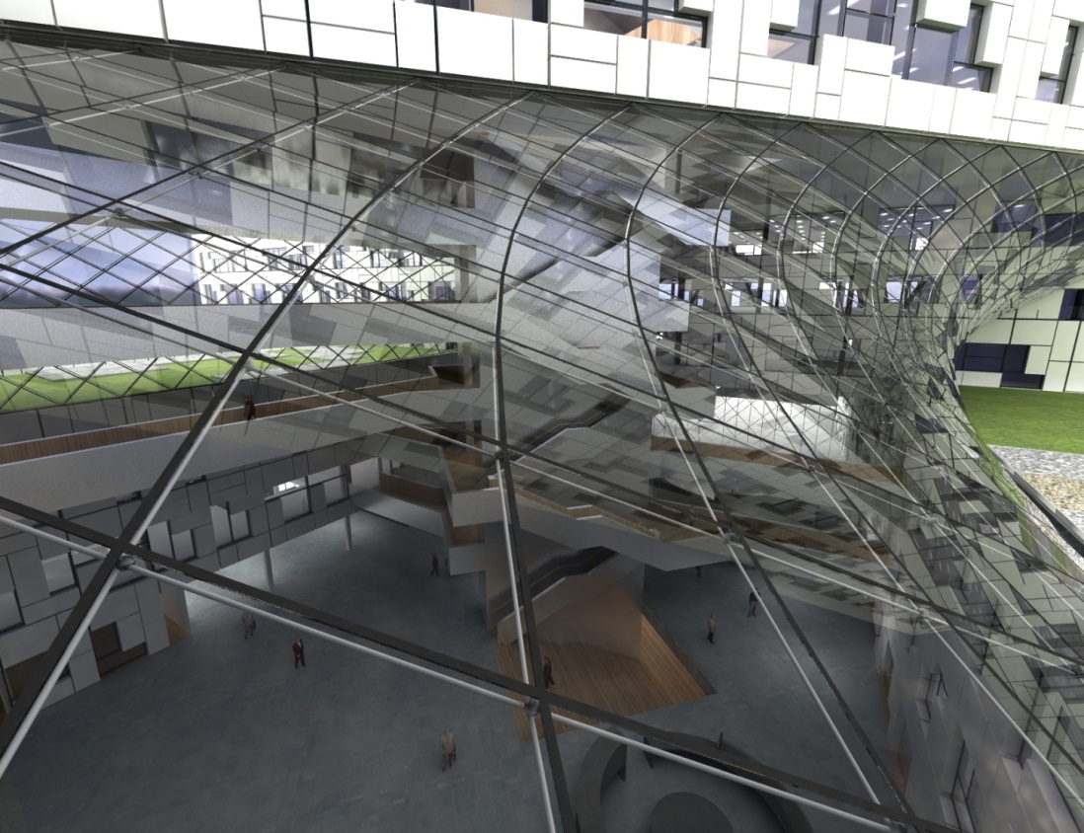
Skanska Norway - Statoil Fornebu
Learning points - spectacular architecture
Through superb cooperation between contractor, architect and consultants we broke records span + construction time

Slide 7
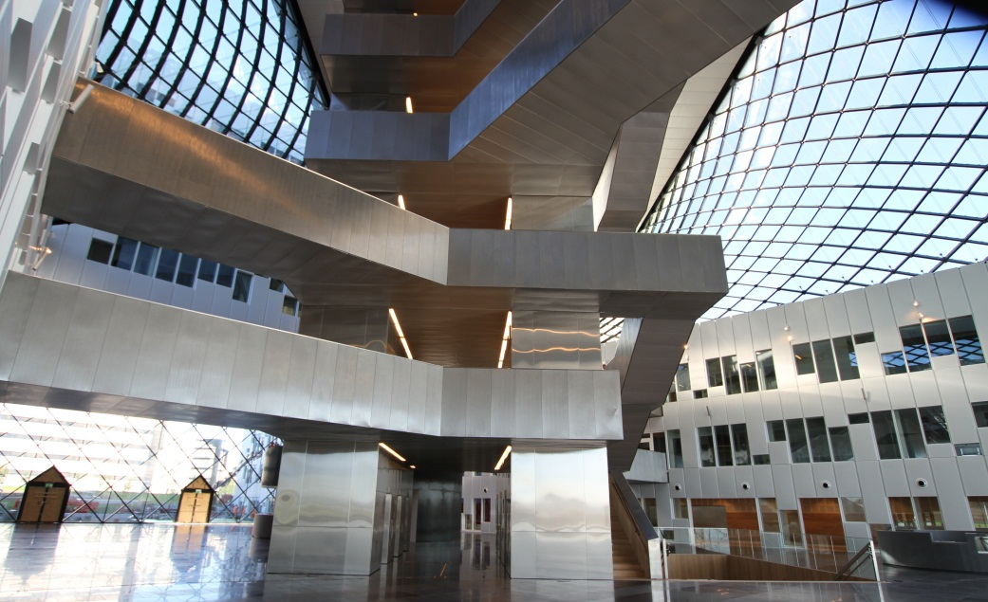
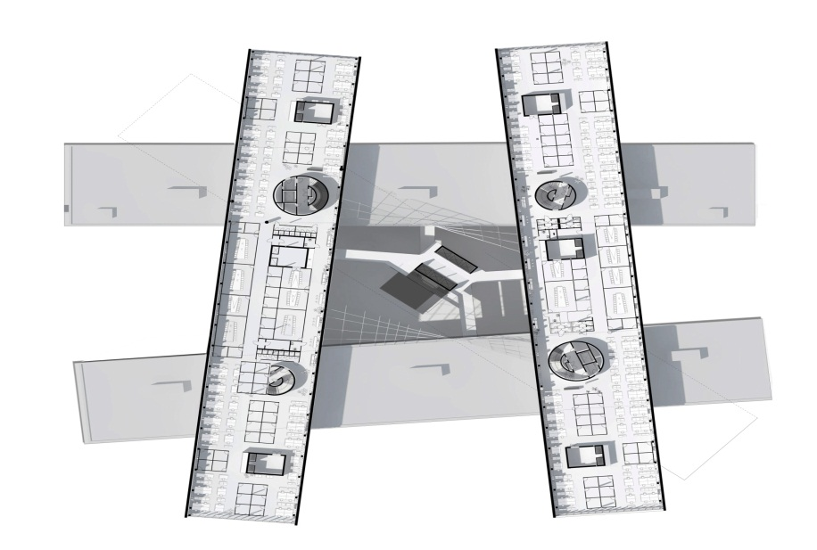
Skanska Norway - Statoil Fornebu
Facts – advanced indoor climate
Target world’s best indoor climate
Every technical application managed from one top system which can control every individual component

Slide 8
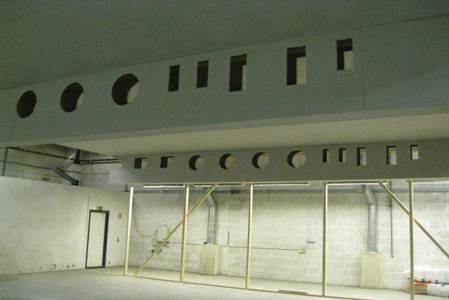
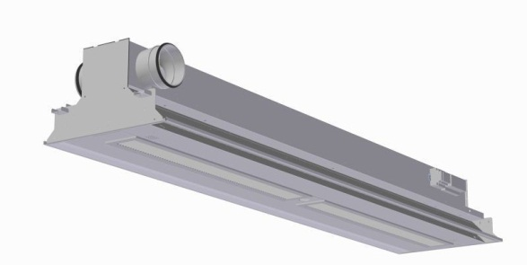
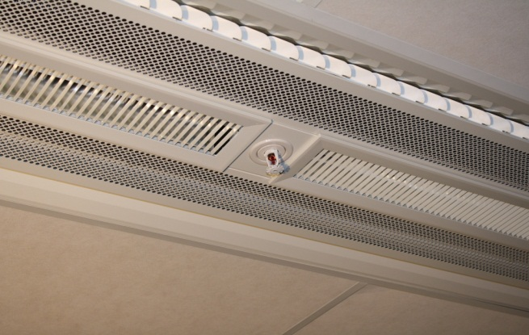
Skanska Norway - Statoil Fornebu
Challenges – advanced indoor climate
Integrated chilled beam tested at factory and after completion. Entire system every individual component
Communication between involved parties firstly communication between people developing systems secondly between the systems themselves
Development of the integrated chilled beam the heart/core of the building’s flexibility the combination of all climatic requirements

Slide 9
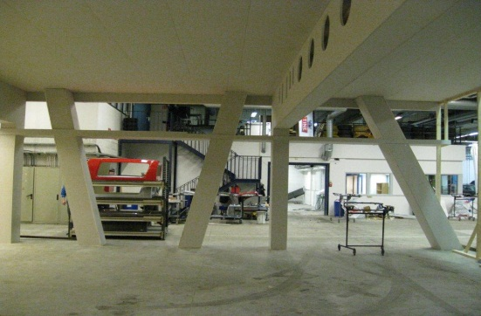
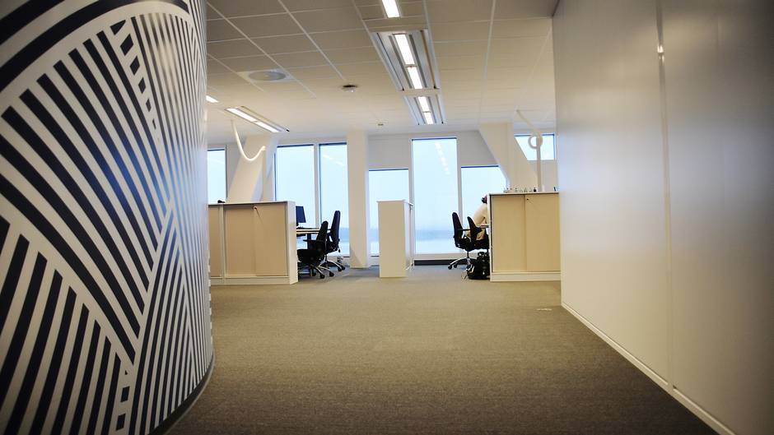
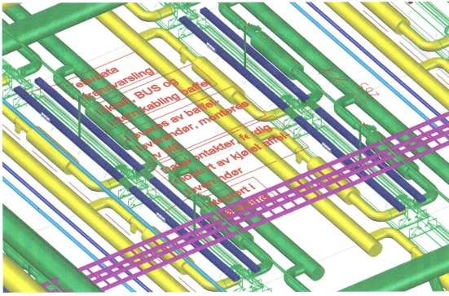
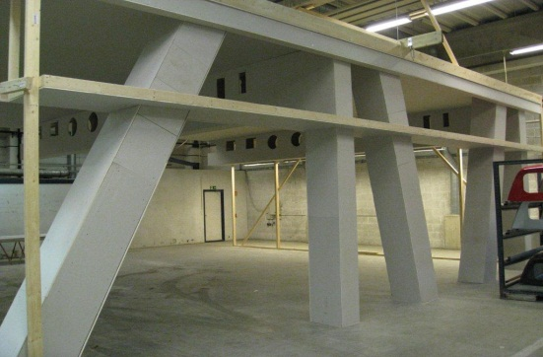
Skanska Norway - Statoil Fornebu
Learning points – advanced indoor climate
The role of the integrator crucial need to understand the complexity
Mock-up room level of detail, size and scale. Everything was testet in the mock-up room

Slide 10
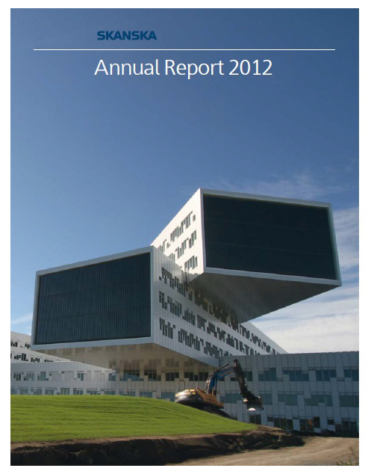
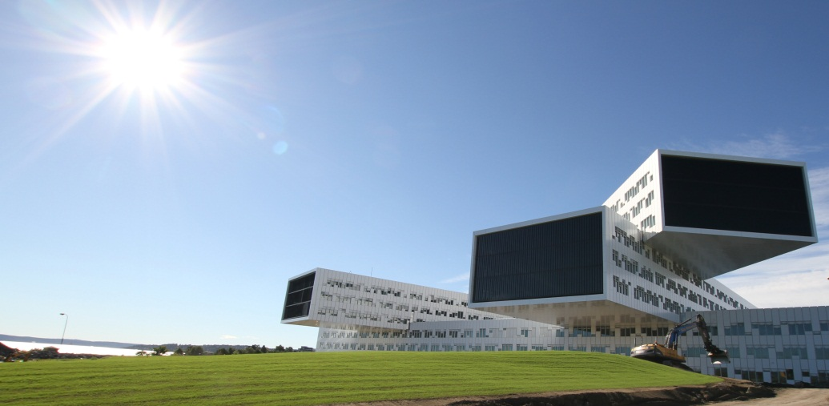
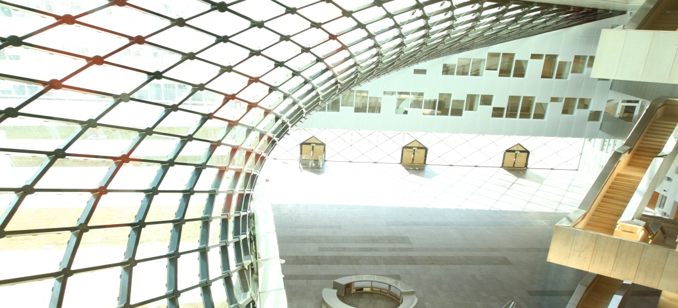
Association of Consulting Architects in Norway’s Developer Award 2012
Statoil Fornebu

